Slide 1


context-based clustering
Ha-Rang Kim
25.5.11
ⓒSaebyeol Yu. Saebyeol’s PowerPoint

Slide 2
Table of contents
1
Conditional Fuzzy C-Means witold pedrycz
2
Space Partition using Context Fuzzy c-Means Algorithm for Image Segmentation

Slide 3
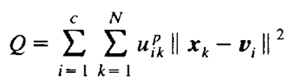


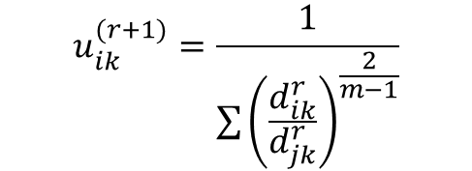
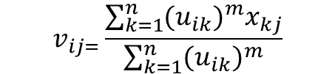
Conditional Fuzzy C-Means
Generic version of FCM
$$v_{ij=}\frac{\sum_{k=1}^{n}{{{(u}_{ik})}^{m}x_{kj}}}{\sum_{k=1}^{n}{{{(u}_{ik})}^{m}}}$$
$$u_{ik}^{(r+1)}=\frac{1}{\sum{{\left(\frac{d_{ik}^{r}}{d_{jk}^{r}}\right)}^{\frac{2}{m−1}}}}$$

Slide 4




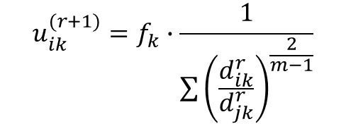

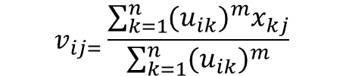



Conditional Fuzzy C-Means
Modification version
$$v_{ij=}\frac{\sum_{k=1}^{n}{{{(u}_{ik})}^{m}x_{kj}}}{\sum_{k=1}^{n}{{{(u}_{ik})}^{m}}}$$
$$u_{ik}^{(r+1)}=f_{k}∙\frac{1}{\sum{{\left(\frac{d_{ik}^{r}}{d_{jk}^{r}}\right)}^{\frac{2}{m−1}}}}$$

Slide 5
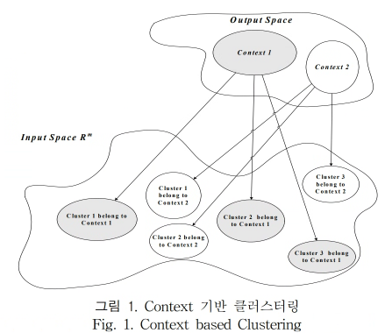
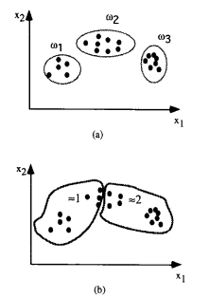
Conditional Fuzzy C-Means
Modification version
-the design of RBFNN
-the construction of fuzzy rule-based classifiers

Slide 6
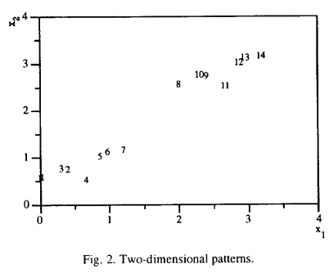
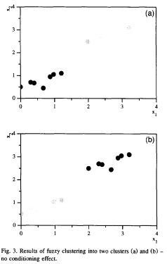
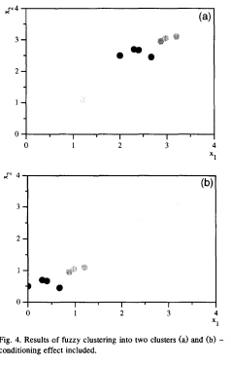
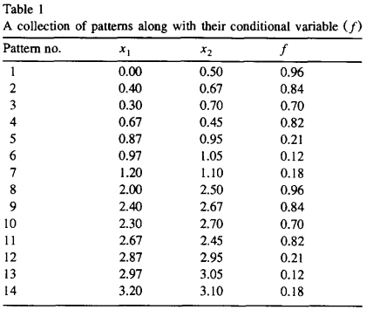
Conditional Fuzzy C-Means

Slide 7
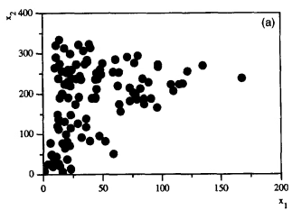
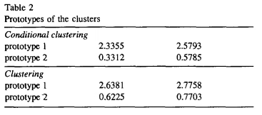

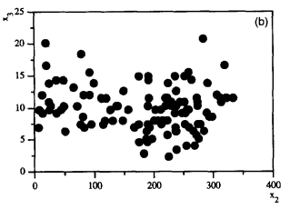
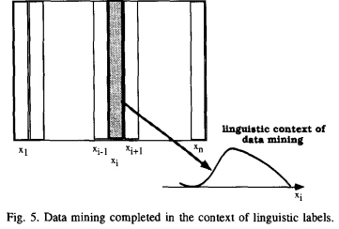
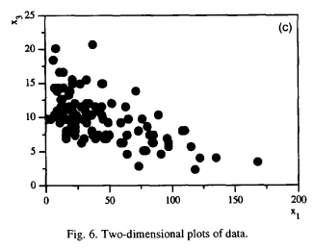
Conditional Fuzzy C-Means

Slide 8
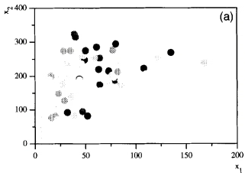
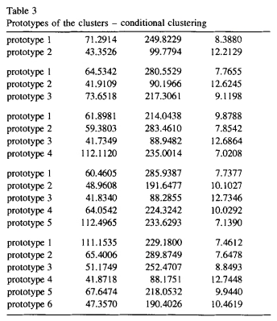
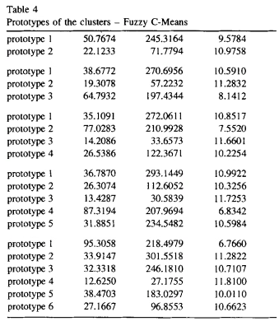
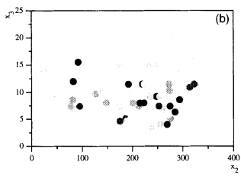
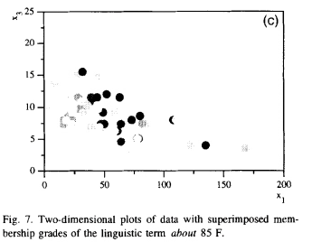

Conditional Fuzzy C-Means
$$MF=exp⁡(−\frac{{(x4−85)}^{2}}{5})$$

Slide 9
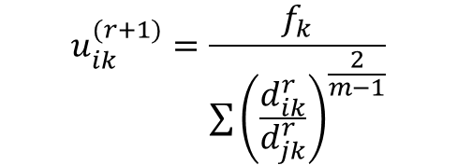
Conditional Fuzzy C-Means
fk = MF value of xk to a fuzzy context
Sample | xk | MF (fk)
1 | X1 | Exp(…)
2 | x2 | “”
Clustering Participation
(normalization)
$$u_{ik}^{(r+1)}=\frac{f_{k}}{\sum{{\left(\frac{d_{ik}^{r}}{d_{jk}^{r}}\right)}^{\frac{2}{m−1}}}}$$

Slide 10
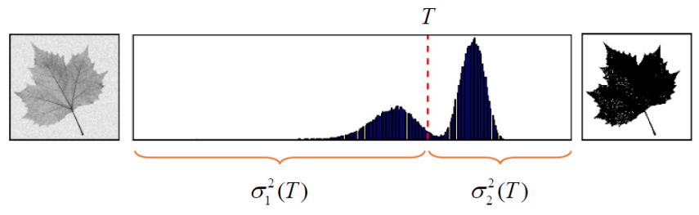
Space Partition using CFCM Algorithm for Image Segmentation
Otsu algorithm thresholding
(Minimum value of variance)
background
binarization
object

Slide 11
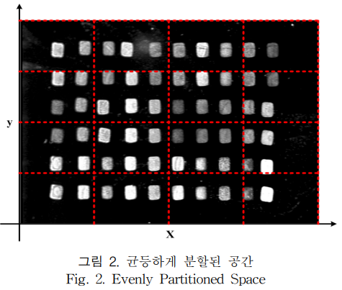
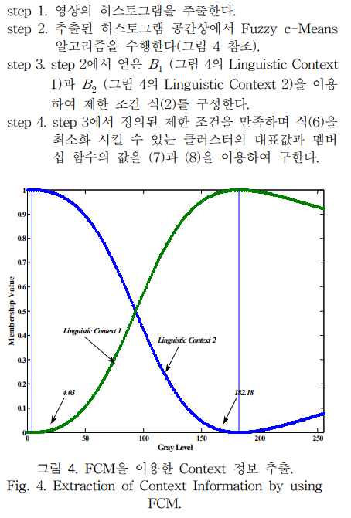
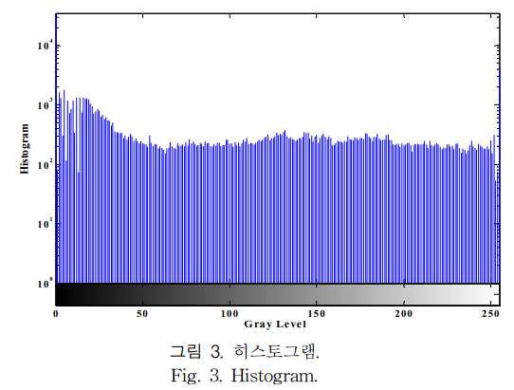
Space Partition using CFCM Algorithm for Image Segmentation

Slide 12
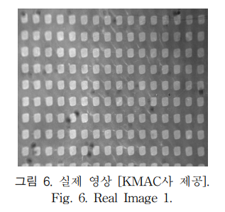
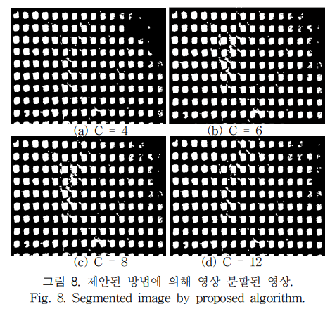
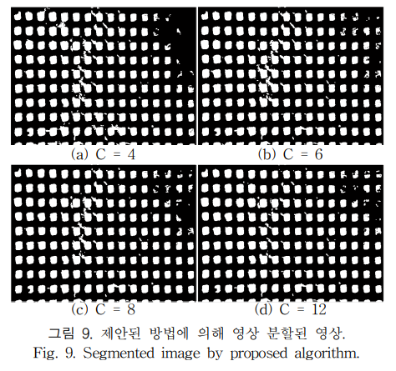
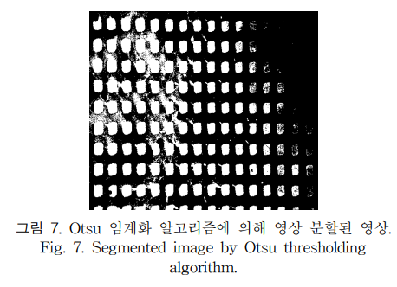
Space Partition using CFCM Algorithm for Image Segmentation
Context : 2
Context : 3

